Slide 1

Chapter 10,
Mapping Models to Code

Slide 2
State of the Art:
Model-based Software Engineering
The Vision
  During object design we build an object design model that realizes the use case model, and which is the basis for implementation (model-driven design)
The Reality
  Working on the object design model involves many activities that are error prone
  Examples:
    A new parameter must be added to an operation. Because of time pressure it is added to the source code, but not to the object model
    Additional attributes are added to an entity object, but the data base table is not updated (as a result, the new attributes are not persistent).
Notes:
The Vision
During object design we would like to implement a system that realizes the use cases specified during requirements elicitation and system design.
The Reality
Different developers usually handle contract violations differently.
Undocumented parameters are often added to the API to address a requirement change.
Additional attributes are usually added to the object model, but are not handled by the persistent data management system, possibly because of a miscommunication.
Many improvised code changes and workarounds are made ad hoc, which eventually leads to a severe degradation of the system.

Slide 3
Other Object Design Activities
Programming languages do not support the concept of a UML association
  The associations of the object model must be transformed into collections of object references
Many programming languages do not support contracts (invariants, pre and post conditions)
  Developers must therefore manually transform contract specification into source code for detecting and handling contract violations
The client changes the requirements during object design
  The developer must change the interface specification of the involved classes
All these object design activities cause problems, because they need to be done manually.

Slide 4
Let us get a handle on these problems
To do this we distinguish two kinds of spaces
  the model space and the source code space
and 4 different types of transformations
  Model transformation
  Forward engineering
  Reverse engineering
  Refactoring.

Slide 5
4 Different Types of Transformations
Program
(in Java)
Yet Another
System Model
Another
System Model
Forward
engineering
Refactoring
Model
transformation
Another
Program
Reverse
engineering
System Model
(in UML)
Model space
Source code space

Slide 6

Model Transformation Example
Object design model before transformation:
LeagueOwner
Advertiser
Player
+email:Address
+email:Address
+email:Address
Object design model after transformation:
User
+email:Address
LeagueOwner
Advertiser
Player

Slide 7
4 Different Types of Transformations
Program
(in Java)
Yet Another
System Model
Another
System Model
Forward
engineering
Refactoring
Model
transformation
Another
Program
Reverse
engineering
System Model
(in UML)
Model space
Source code space

Slide 8
Refactoring Example: Pull Up Field
public class Player {
private String email;
//...
}
public class LeagueOwner {
private String eMail;
//...
}
public class Advertiser {
private String email_address;
//...
}
public class User {
private String email;
}
public class Player extends User {
//...
}
public class LeagueOwner extends User {
//...
}
public class Advertiser extends User {
//...
}

Slide 9
Refactoring Example: Pull Up Constructor Body
public class User {
private String email;
}
public class Player extends User {
public Player(String email) {
this.email = email;
}
}
public class LeagueOwner extends User{
public LeagueOwner(String email) {
this.email = email;
}
}
public class Advertiser extendsUser{
public Advertiser(String email) {
this.email = email;
}
}
public class User {
public User(String email) {
this.email = email;
}
}
public class Player extends User {
public Player(String email) {
super(email);
}
}
public class LeagueOwner extends User {
public LeagueOwner(String email) {
super(email);
}
}
public class Advertiser extends User {
public Advertiser(String email) {
super(email);
}
}

Slide 10
4 Different Types of Transformations
Program
(in Java)
Yet Another
System Model
Another
System Model
Forward
engineering
Refactoring
Model
transformation
Another
Program
Reverse
engineering
System Model
(in UML)
Model space
Source code space

Slide 11

Forward Engineering Example
Object design model before transformation:
User
LeagueOwner
-email:String
-maxNumLeagues:int
+getEmail():String
+setEmail(e:String)
+notify(msg:String)
+getMaxNumLeagues():int
+setNaxNumLeagues(n:int)
Source code after transformation:
public class User {
private String email;
public String getEmail() {
return email;
}
public void setEmail(String value){
email = value;
}
public void notify(String msg) {
// ....
}
}
public class LeagueOwner extends User {
private int maxNumLeagues;
public int getMaxNumLeagues() {
return maxNumLeagues;
}
public void setMaxNumLeagues
(int value) {
maxNumLeagues = value;
}
}

Slide 12
More Examples of Model Transformations and Forward Engineering
Model Transformations
  Goal: Optimizing the object design model
    Collapsing objects
    Delaying expensive computations
Forward Engineering
  Goal: Implementing the object design model in a programming language
  Mapping inheritance
  Mapping associations
  Mapping contracts to exceptions
  Mapping object models to tables

Slide 13
Collapsing Objects
Object design model before transformation:
Person
SocialSecurity
number:String
Object design model after transformation:
Person
SSN:String
Turning an object into an attribute of another object is usually
done, if the object does not have any interesting dynamic behavior
(only get and set operations).

Slide 14
Examples of Model Transformations and Forward Engineering
Model Transformations
  Goal: Optimizing the object design model
    Collapsing objects
    Delaying expensive computations
Forward Engineering
  Goal: Implementing the object design model in a programming language
  Mapping inheritance
  Mapping associations
  Mapping contracts to exceptions
  Mapping object models to tables

Slide 15
Delaying expensive computations
Object design model before transformation:
Image
filename:String
data:byte[]
paint()
Object design model after transformation:
Proxy Pattern!
Image
filename:String
paint()
image
ImageProxy
1
0..1
RealImage
filename:String
data:byte[]
paint()
paint()
Notes:
Question: Which pattern is being used here? Answer: The proxy pattern!
Why: Image is an analysis domain object, the proxy pattern subclasses Imageproxy and RealImage are solution
domain objects!

Slide 16
Using Different Views in Forward Engineering
Architectural/Statical Views supports a complete automatic code generation 100%
  Goal: Declaration of concepts: classes, interfaces, associations, implementation relationships (between classes and interfaces), import relationships (which correspond to dependencies in UML)
  Full management of associations irrespective of their nature and properties, import declarations
Dynamical Views
  Goal: Generating the code corresponding to:
    state transition diagrams and activities diagrams/flowcharts,
    Sequence/Collaboration(Communication) diagram; method composition
  Mapping inheritance

Slide 17
Using Assertions and Observers in Forward Engineering
OCL specifications can be transformed in OO programming languages. The management of assertion violation depends first on the target programming language and on the generated code, also.
  In case of assertion violation, OCLE print a message.
OCLE restrictions:
  The current version does not consider code generation in case of Dynamical Views. However, due to support of Observers’ code generation, the percent of code generated by OCLE is 70-75%. The missing part must be manually written.

Slide 18
Examples of Model Transformations and Forward Engineering
Model Transformations
  Goal: Optimizing the object design model
    Collapsing objects
    Delaying expensive computations
Forward Engineering
  Goal: Implementing the object design model in a programming language
  Mapping inheritance
  Mapping associations
  Mapping contracts to exceptions
  Mapping object models to tables

Slide 19
Forward Engineering: Mapping a UML Model into Source Code
Goal: We have a UML-Model with inheritance. We want to translate it into source code
Question: Which mechanisms in the programming language can be used?
  Let’s focus on Java
Java provides the following mechanisms:
  Overwriting of methods (default in Java)
  Final classes
  Final methods
  Abstract methods
  Abstract classes
  Interfaces.
Notes:
For each of these mechanisms a project manager can specify heuristics to use them properly

Slide 20
Realizing Inheritance in Java
Realisation of specialization and generalization
  Definition of subclasses
  Java keyword: extends
Realisation of simple inheritance
  Overwriting of methods is not allowed
  Java keyword: final
Realisation of implementation inheritance
  Overwriting of methods
  No keyword necessary:
    Overwriting of methods is default in Java
Realisation of specification inheritance
  Specification of an interface
  Java keywords: abstract, interface
Notes:
Java offers several techniques to realize the different types of inheritance:
Realisation of simple inheritance also called strict inheritance

Slide 21
Example for the use of Abstract Methods: Cryptography
Problem: Delivery a general encryption method
Requirements:
  The system provides algorithms for existing encryption methods (e.g. Caesar, Transposition)
  New encryption algorithms, when they become available, can be linked into the program at runtime, without any need to recompile the program
  The choice of the best encryption method can also be done at runtime.

Slide 22
Object Design of Chiffre
Chiffre
We define a super class Chiffre and define subclasses for the existing existing encryption methods
4 public methods:
  encrypt() encrypts a text of words
  decrypt() deciphers a text of words
  encode() uses a special algorithm for encryption of a single word
  decode() uses a special algorithm for decryption of a single word.
+encrypt()
+decrypt()
+encode()
+decode()
Caesar
Transpose
+encode()
+decode()
+encode()
+decode()
Notes:
Chiffre offers 4 public methods:

Slide 23
Implementation of Chiffre in Java
The methods encrypt() and decrypt() are the same for each subclass and can therefore be implemented in the superclass Chiffre
  Chiffre is defined as subclass of Object, because we will use some methods of Object
The methods encode() and decode() are specific for each subclass
  We therefore define them as abstract methods in the super class and expect that they are implemented in the respective subclasses.
Object
Chiffre
Caesar
Transpose
Exercise: Write
the corresponding Java
Code!
Notes:
The class Chiffre is abstract, because some of its methods are not implemented by the class

Slide 24
Examples of Model Transformations and Forward Engineering
Model Transformations
  Goal: Optimizing the object design model
    Collapsing objects
    Delaying expensive computations
Forward Engineering
  Goal: Implementing the object design model in a programming language
  Is it the model compilable?
  Mapping inheritance
  Mapping associations
  Mapping contracts to exceptions
  Mapping object models to tables

Slide 25
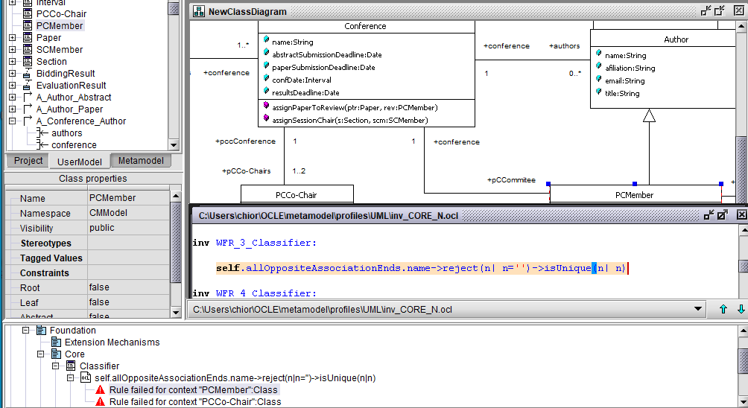
Is it the model compilable?

Slide 26
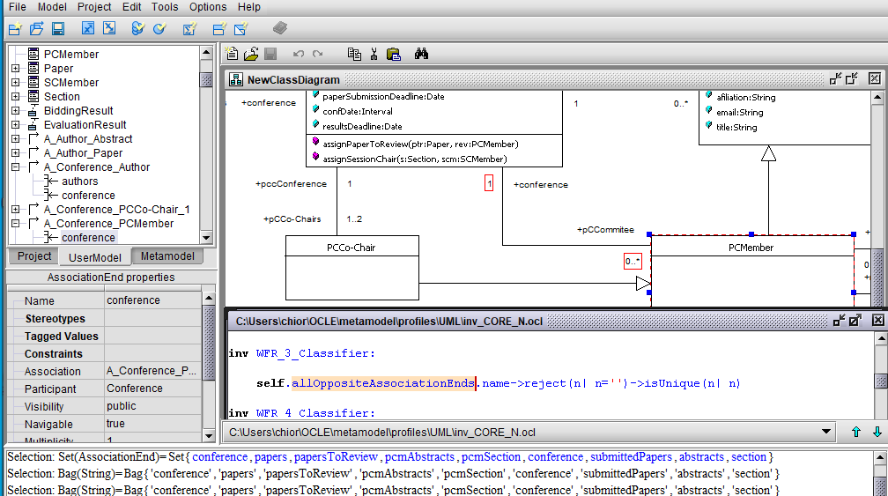
Is it the model compilable? cont.

Slide 27
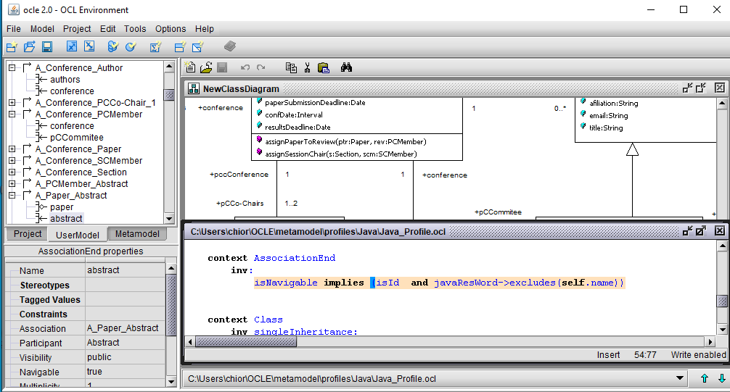
Is it the model compilable? Java Profile

Slide 28
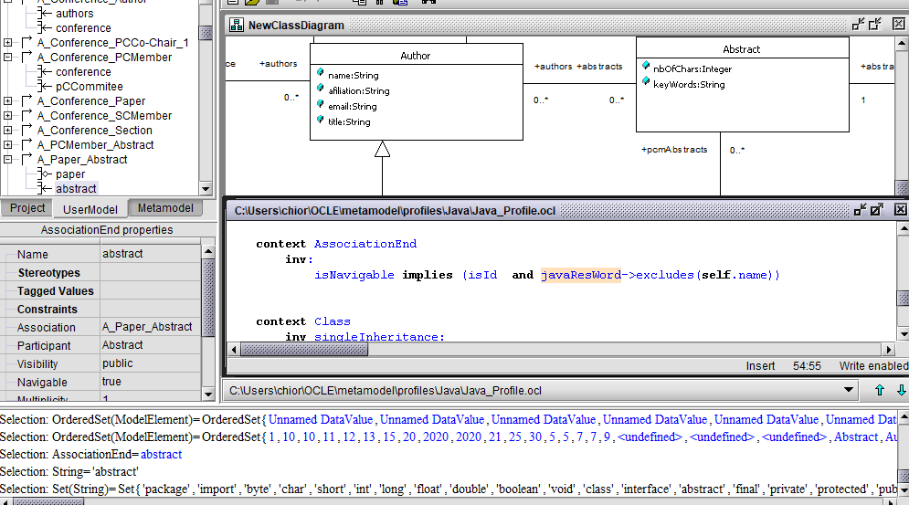
Is it the model compilable? Java Profile

Slide 29
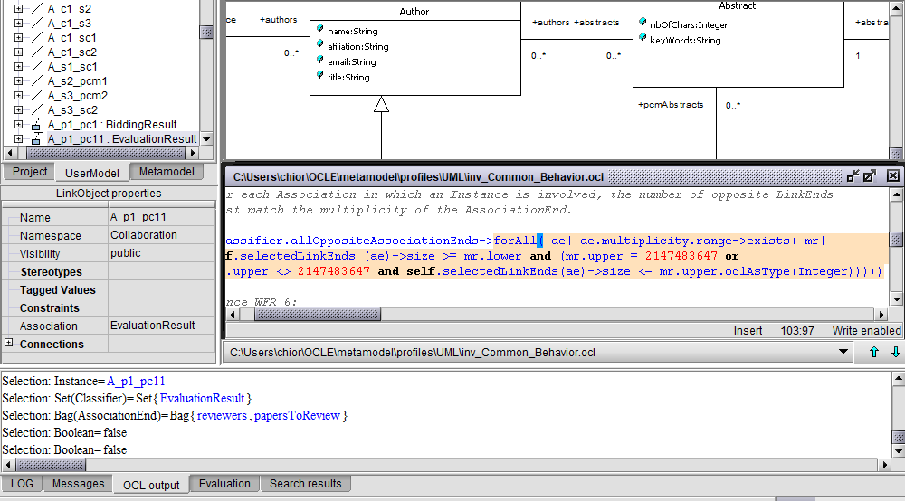
Is it the model compilable? Common behavior

Slide 30
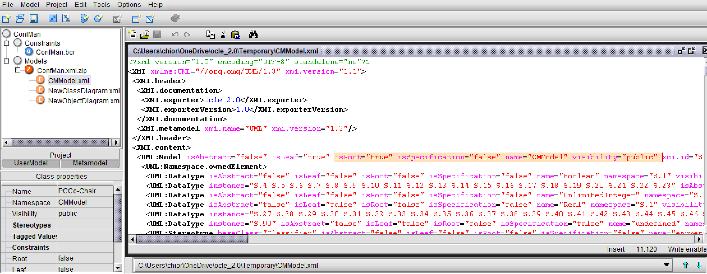
Model serialization in OCLE - CMModel

Slide 31
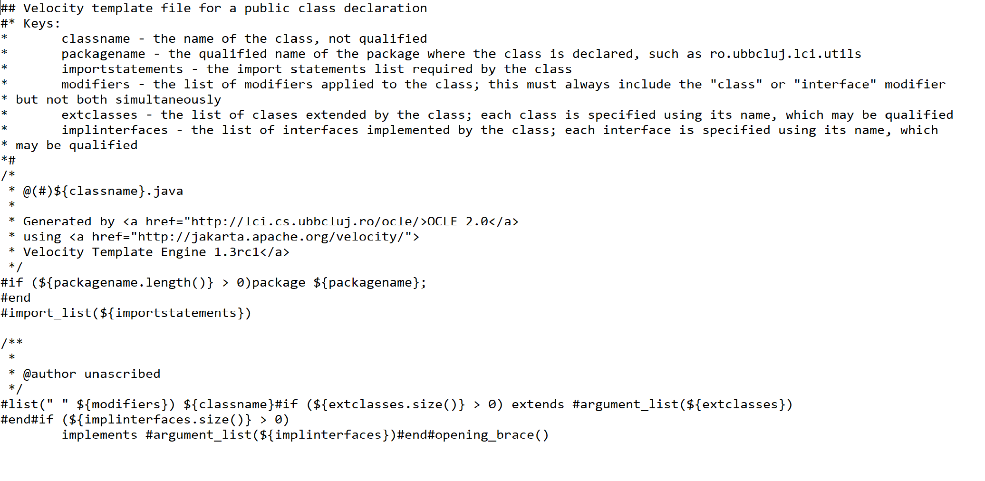
Velocity Template Engine 1.3rc1

Slide 32
Mapping Associations
Unidirectional one-to-one association
Bidirectional one-to-one association
Bidirectional one-to-many association
Bidirectional many-to-many association
Bidirectional qualified association.

Slide 33
Unidirectional one-to-one association
Object design model before transformation:
Advertiser
Account
Source code after transformation:
public class Advertiser {
private Account account;
public Advertiser() {
account = new Account();
}
public Account getAccount() {
return account;
}
}
Notes:
If Advertiser accesses only Account, but not vice versa, the class Account can be made a local attribute in the Advertiser class

Slide 34
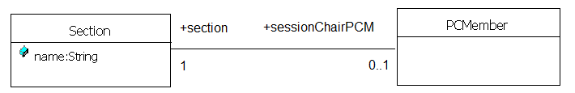
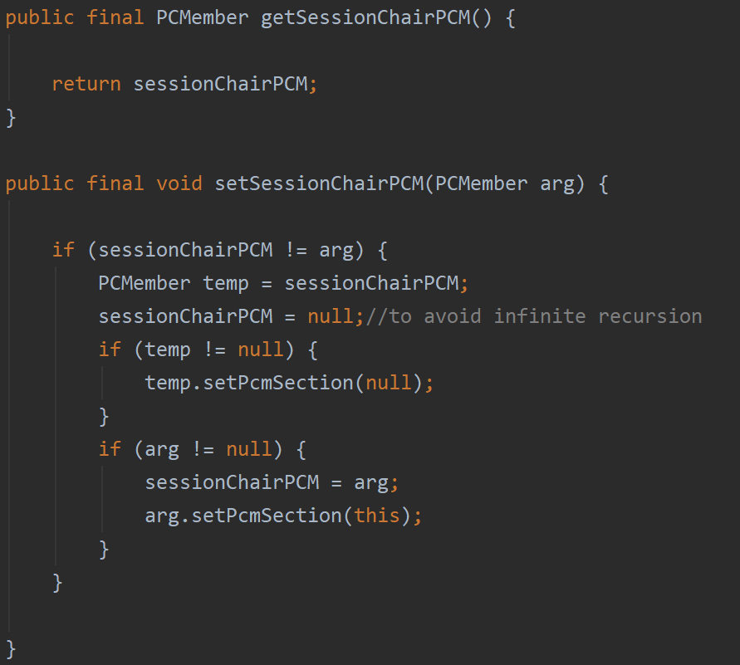
Bidirectional one-to-one association

Slide 35
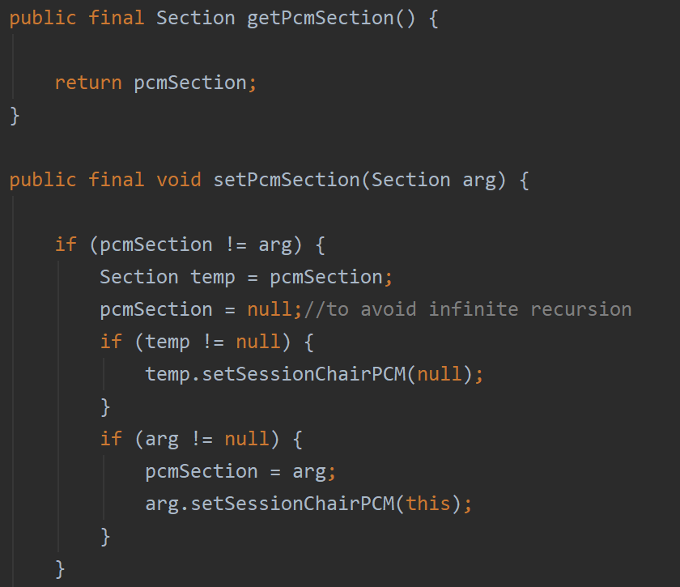
Bidirectional one-to-one association

Slide 36
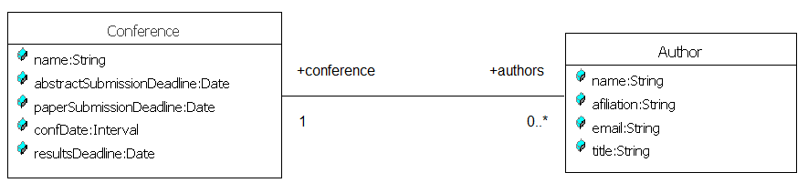
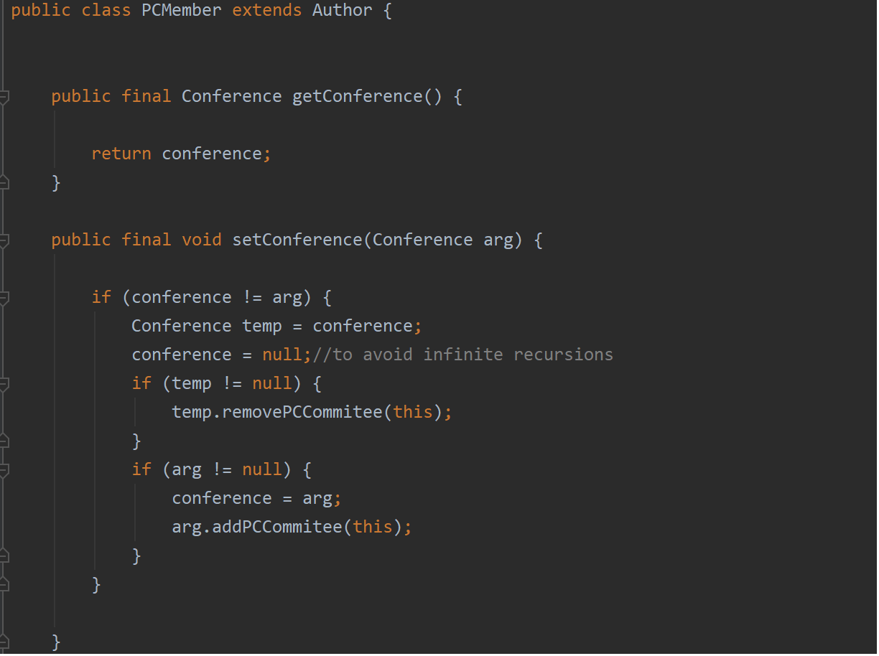
Bidirectional one-to-many association
Notes:
If Advertiser accesses only Account, but not vice versa, the class Account can be made a local attribute in the Advertiser class

Slide 37
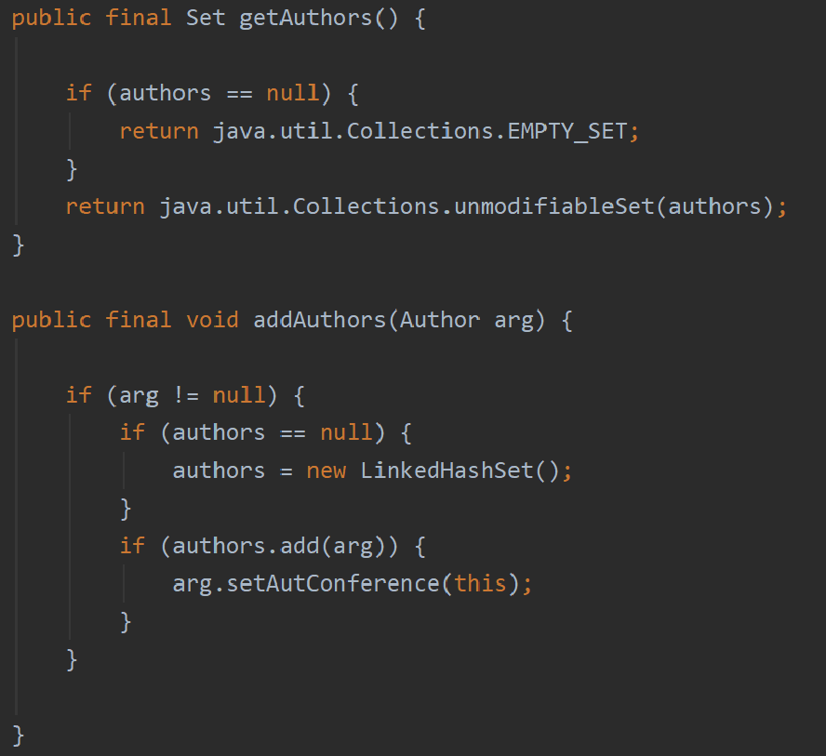
Bidirectional one-to-many association
Notes:
If Advertiser accesses only Account, but not vice versa, the class Account can be made a local attribute in the Advertiser class

Slide 38
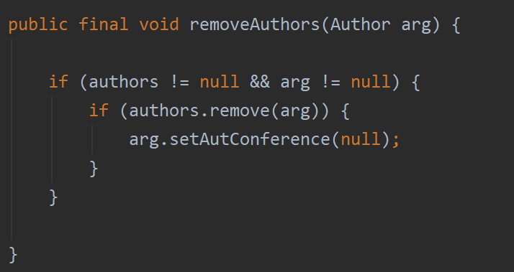
Bidirectional one-to-many association
Notes:
If Advertiser accesses only Account, but not vice versa, the class Account can be made a local attribute in the Advertiser class

Slide 39
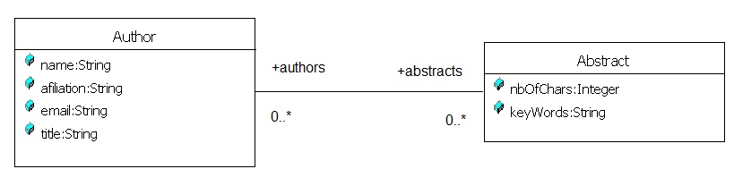
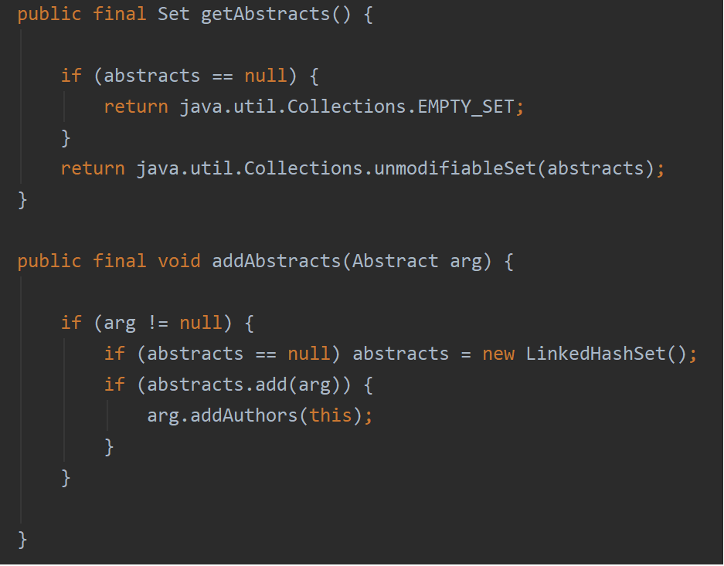
Bidirectional many-to-many association

Slide 40
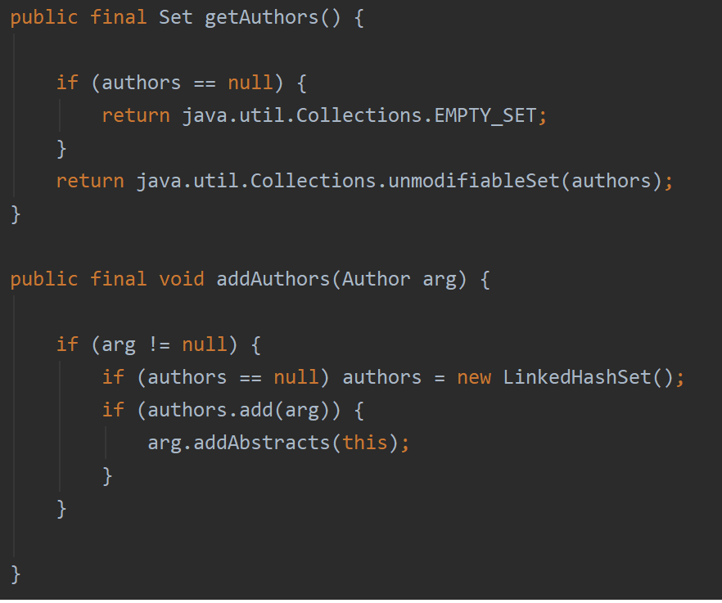
Bidirectional many-to-many association

Slide 41
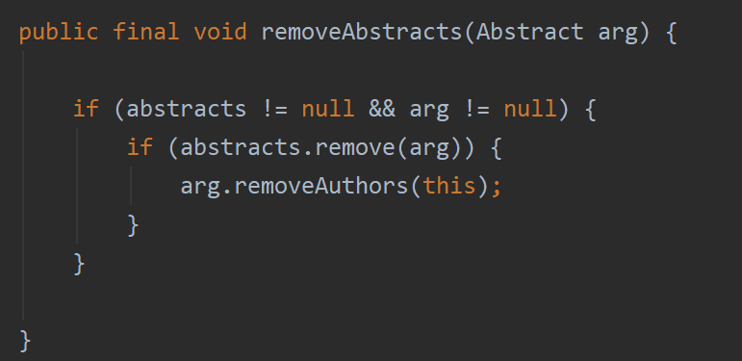
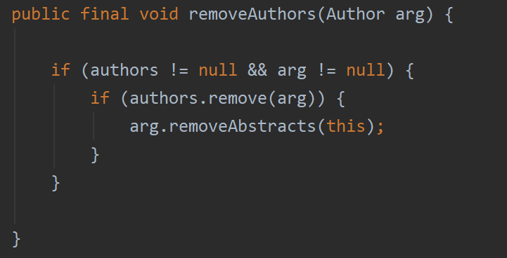
Bidirectional many-to-many association

Slide 42
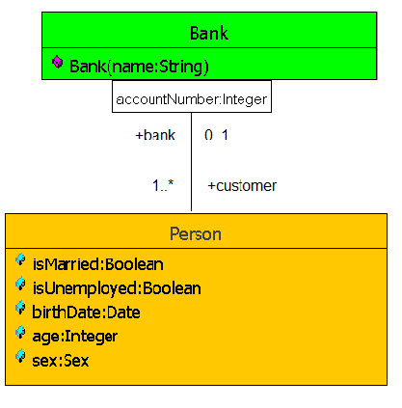
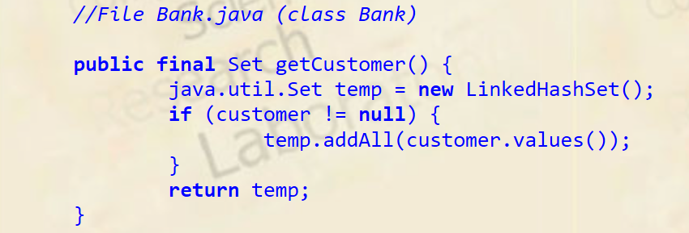
Bidirectional qualified association

Slide 43
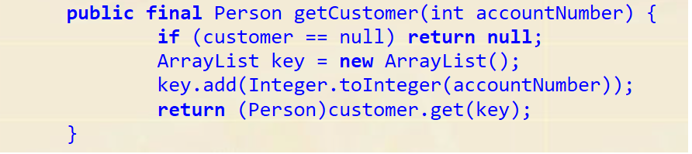
Bidirectional qualified association

Slide 44
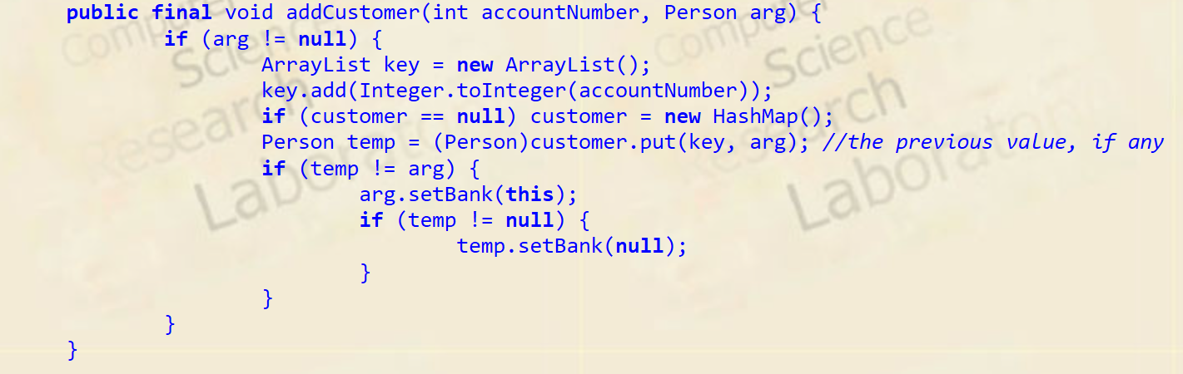
Bidirectional qualified association

Slide 45
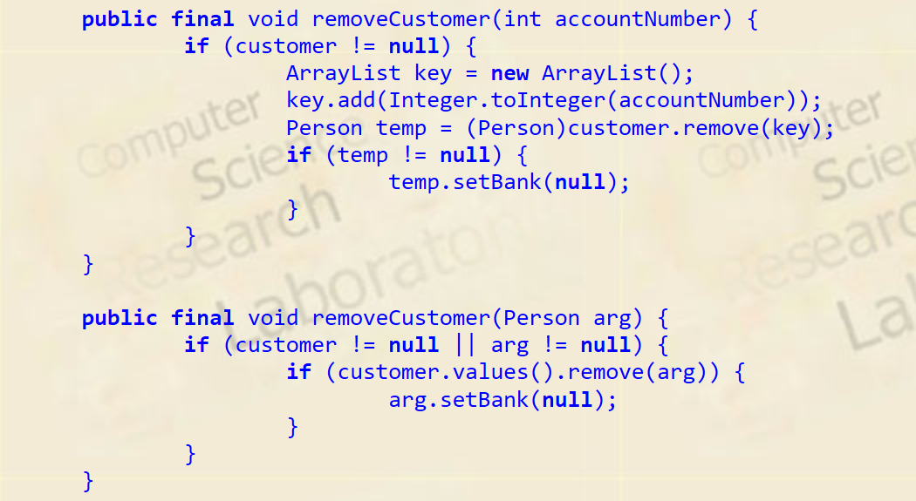
Bidirectional qualified association

Slide 46
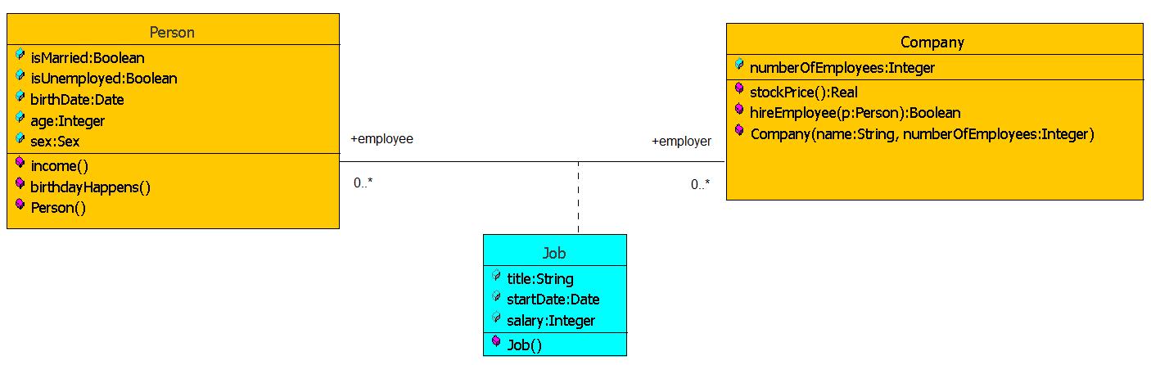
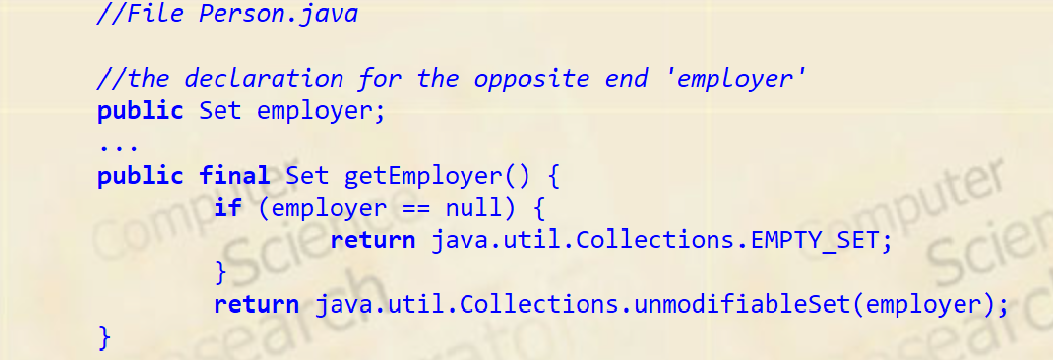
Association class

Slide 47
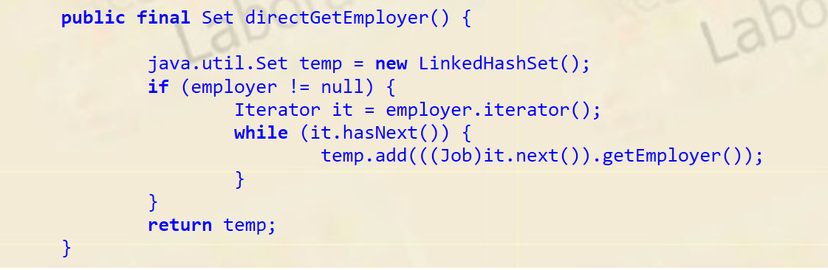
Association class

Slide 48
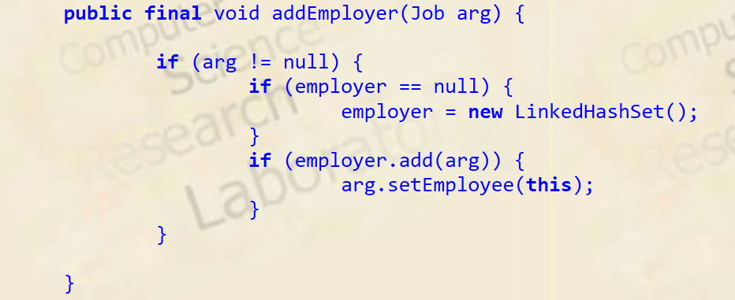
Association class

Slide 49
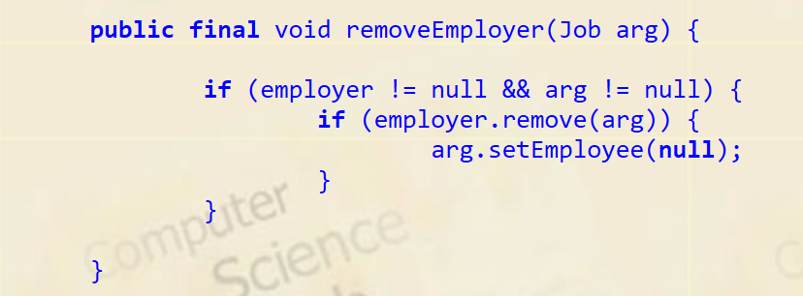
Association class

Slide 50
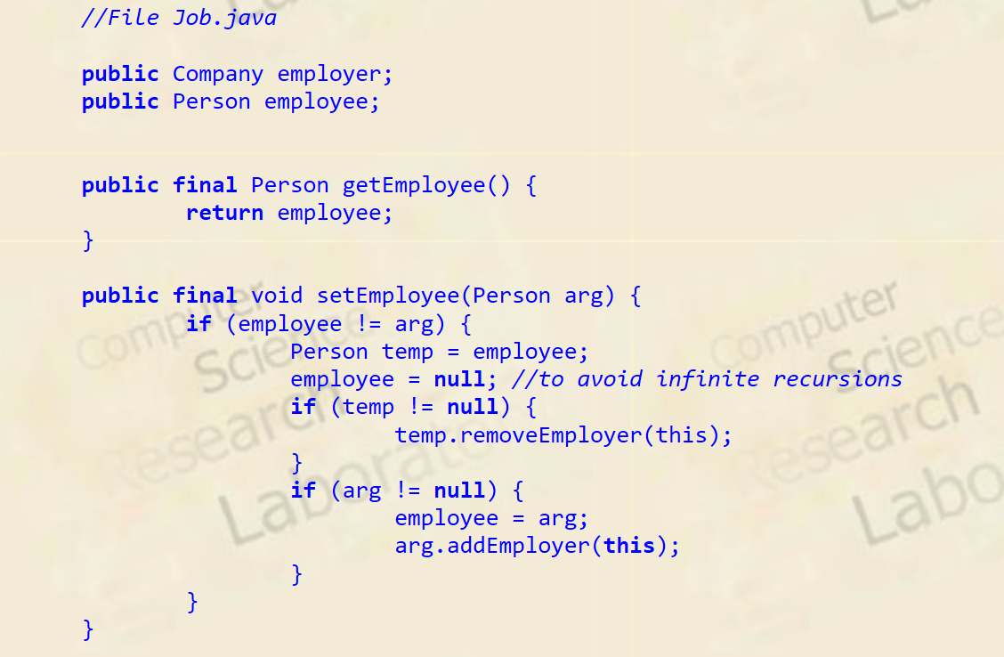
Association class

Slide 51
Examples of Model Transformations and Forward Engineering
Model Transformations
  Goal: Optimizing the object design model
    Collapsing objects
    Delaying expensive computations
Forward Engineering
  Goal: Implementing the object design model in a programming language
  Mapping inheritance
  Mapping associations
  Transforming observers into code
  Mapping contracts to exceptions
  Mapping object models to tables

Slide 52
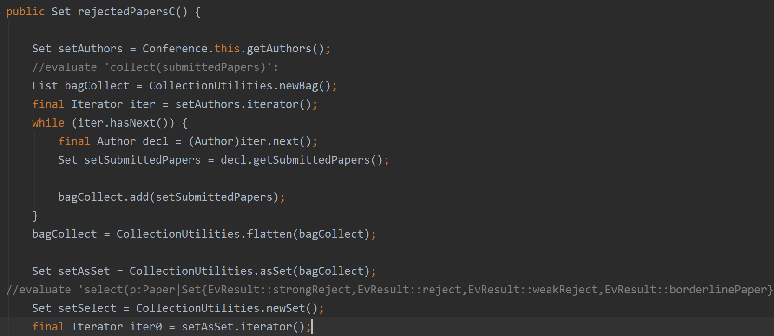
Transforming observers into code

Slide 53
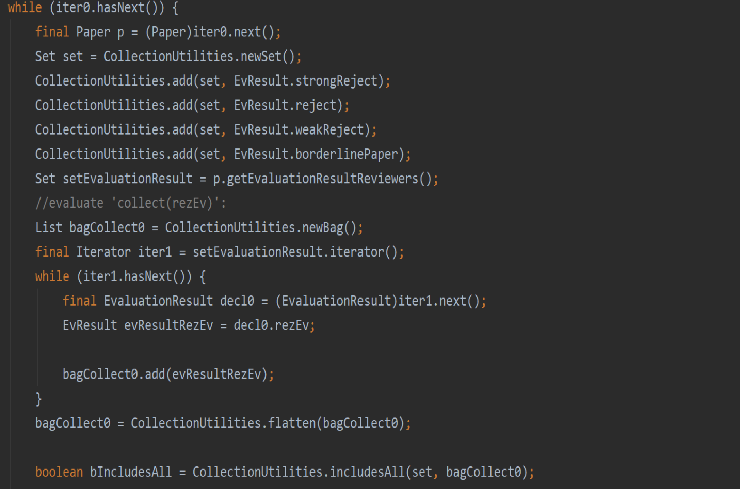
Transforming observers into code _ cont

Slide 54
Implementing Contract Violations
Many object-oriented languages do not have built-in support for contracts
However, if they support exceptions, we can use their exception mechanisms for signaling and handling contract violations
In Java we use the try-throw-catch mechanism
Example:
  Let us assume the acceptPlayer() operation of TournamentControl is invoked with a player who is already part of the Tournament
    UML model (see slide 34)
  In this case acceptPlayer() in TournamentControl should throw an exception of type KnownPlayer
    Java Source code (see slide 35).

Slide 55
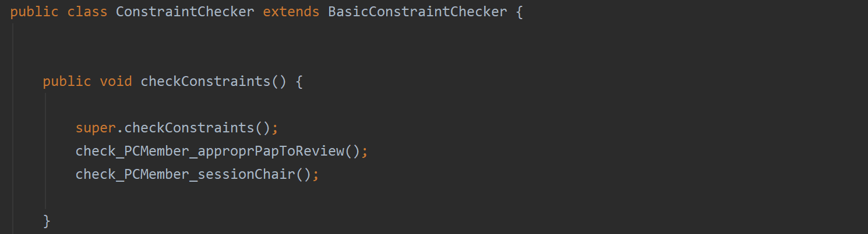
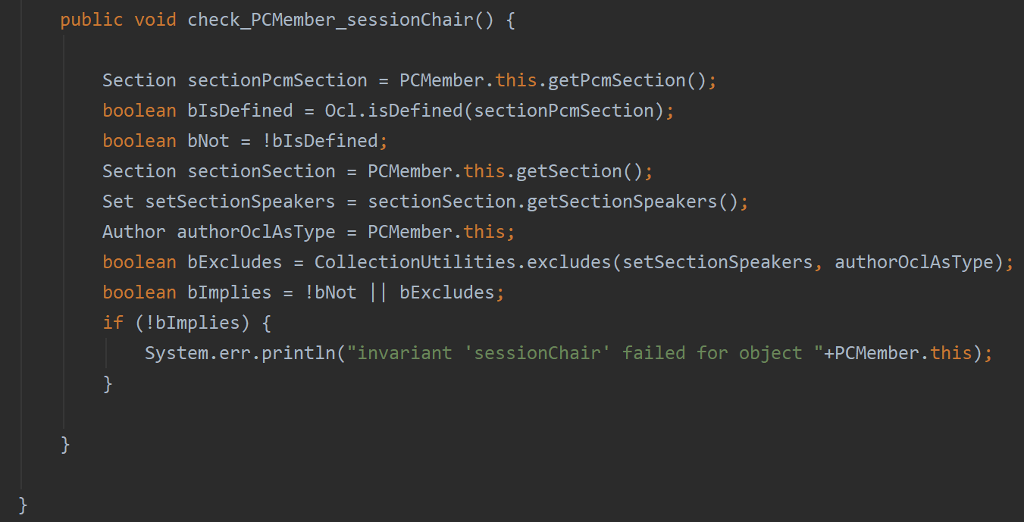
Implementing Contract Violations - invariants

Slide 56
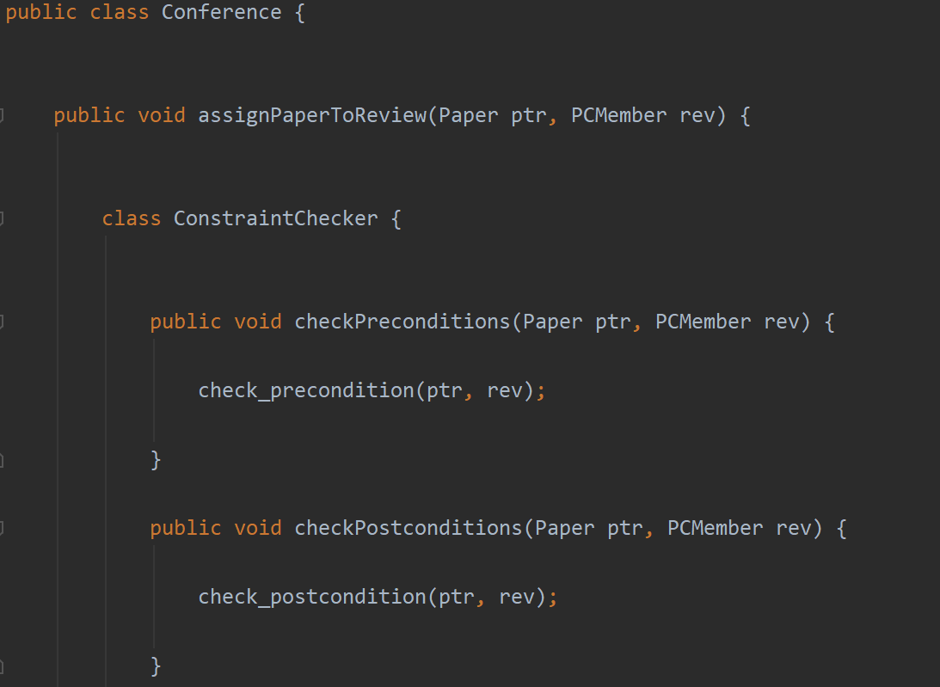
Implementing Contract Violations – pre&post

Slide 57
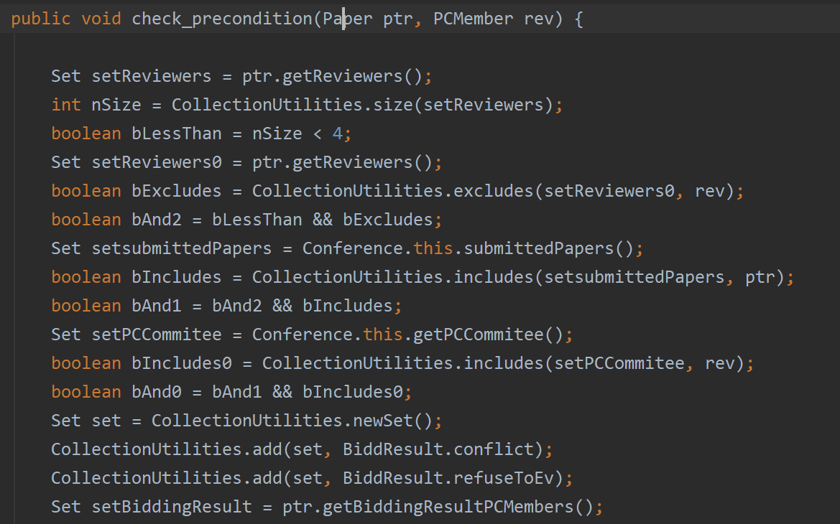
Implementing Contract Violations – pre

Slide 58
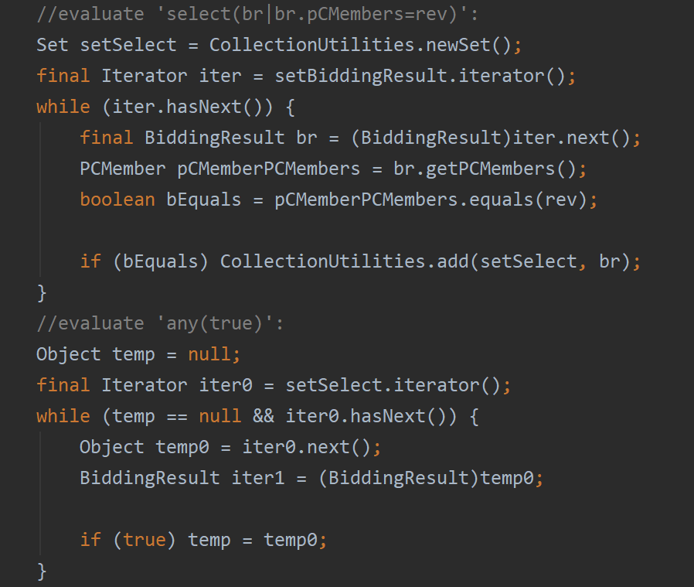
Implementing Contract Violations – pre_2

Slide 59
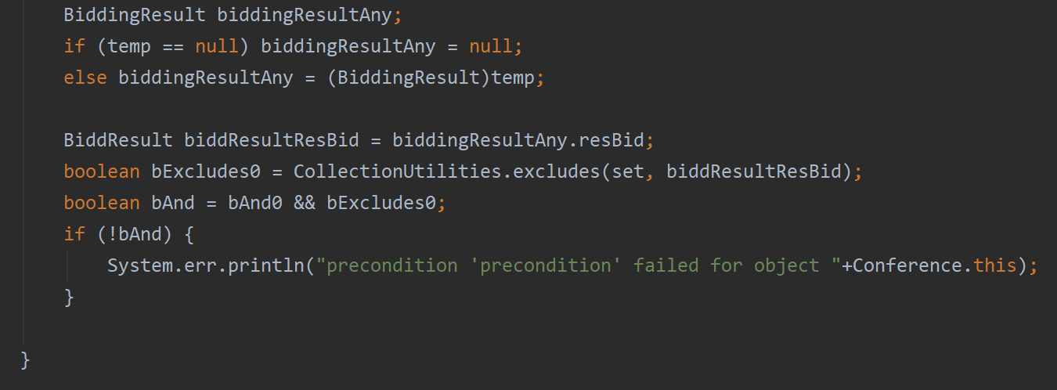
Implementing Contract Violations – pre_3

Slide 60
UML Model for Contract Violation Example
TournamentForm
1
1
+applyForTournament()
TournamentControl
*
+selectSponsors(advertisers):List
*
+advertizeTournament()
+acceptPlayer(p)
+announceTournament()
+isPlayerOverbooked():boolean
1
1
Tournament
*
-maNumPlayers:String
*
*
*
players
+start:Date
sponsors
*
*
+end:Date
Player
+acceptPlayer(p)
Advertiser
*
+removePlayer(p)
+isPlayerAccepted(p)
matches
*
Match
matches
*
+start:Date
+status:MatchStatus
+playMove(p,m)
+getScore():Map

Slide 61
Implementation in Java
TournamentForm
1
1
+applyForTournament()
TournamentControl
*
+selectSponsors(advertisers):List
+advertizeTournament()
*
+acceptPlayer(p)
+announceTournament()
+isPlayerOverbooked():boolean
1
1
Tournament
*
-maNumPlayers:String
*
*
players
+start:Date
*
sponsors
+end:Date
*
*
Player
+acceptPlayer(p)
Advertiser
*
+removePlayer(p)
matches
+isPlayerAccepted(p)
*
matches
Match
*
+start:Date
+status:MatchStatus
+playMove(p,m)
+getScore():Map
public class TournamentForm {
private TournamentControl control;
private ArrayList players;
public void processPlayerApplications() {
for (Iteration i = players.iterator(); i.hasNext();) {
try { control.acceptPlayer((Player)i.next());
}
catch (KnownPlayerException e) {
// If exception was caught, log it to console
ErrorConsole.log(e.getMessage());
}
}
}
}
Notes:
Example of exception handling in Java. TournamentForm catches exceptions raised by Tournament and TournamentControl and logs them into an error console for display to the user. public void processPlayerApplications() { // Go through all the players for (Iteration i = players.iterator(); i.hasNext();) {
try { // Delegate to the control object.
control.acceptPlayer((Player)i.next());
}
catch (KnownPlayerException e) {
// If an exception was caught, log it to the console
ErrorConsole.log(e.getMessage());
}
}
}
}

Slide 62
The try-throw-catch Mechanism in Java
public class TournamentControl {
private Tournament tournament;
public void addPlayer(Player p) throws KnownPlayerException {
if (tournament.isPlayerAccepted(p)) {
throw new KnownPlayerException(p);
}
//... Normal addPlayer behavior
}
}
public class TournamentForm {
private TournamentControl control;
private ArrayList players;
public void processPlayerApplications() {
for (Iteration i = players.iterator(); i.hasNext();) {
try { control.acceptPlayer((Player)i.next());
}
catch (KnownPlayerException e) {
// If exception was caught, log it to console
ErrorConsole.log(e.getMessage());
}
}
}
}
Notes:
Example of exception handling in Java. TournamentForm catches exceptions raised by Tournament and TournamentControl and logs them into an error console for display to the user. public void processPlayerApplications() { // Go through all the players for (Iteration i = players.iterator(); i.hasNext();) {
try { // Delegate to the control object.
control.acceptPlayer((Player)i.next());
}
catch (KnownPlayerException e) {
// If an exception was caught, log it to the console
ErrorConsole.log(e.getMessage());
}
}
}
}

Slide 63
TournamentForm
1
1
+applyForTournament()
TournamentControl
*
+selectSponsors(advertisers):List
*
+advertizeTournament()
+acceptPlayer(p)
+announceTournament()
+isPlayerOverbooked():boolean
1
1
Tournament
*
-maNumPlayers:String
*
*
*
players
+start:Date
sponsors
*
*
+end:Date
Player
+acceptPlayer(p)
Advertiser
*
+removePlayer(p)
+isPlayerAccepted(p)
matches
*
Match
matches
*
+start:Date
+status:MatchStatus
+playMove(p,m)
+getScore():Map

Slide 64
Implementing a Contract
Check each precondition:
  Before the beginning of the method with a test to check the precondition for that method
    Raise an exception if the precondition evaluates to false
Check each postcondition:
  At the end of the method write a test to check the postcondition
    Raise an exception if the postcondition evaluates to false. If more than one postcondition is not satisfied, raise an exception only for the first violation.
Check each invariant:
  Check invariants at the same time when checking preconditions and when checking postconditions
Deal with inheritance:
  Add the checking code for preconditions and postconditions also into methods that can be called from the class.
Notes:
For each operation in the contract, do the following
Check precondition: Check the precondition before the beginning of the method with a test that raises an exception if the precondition is false.
Check postcondition: Check the postcondition at the end of the method and raise an exception if the contract is violoated. If more than one postcondition is not satisfied, raise an exception only for the first violation.
Check invariant: Check invariants at the same time as postconditions.
Deal with inheritance: Encapsulate the checking code for preconditions and postconditions into separate methods that can be called from subclasses.

Slide 65
A complete implementation of the Tournament.addPlayer() contract
«invariant»
getMaxNumPlayers() > 0
Tournament
«precondition»
!isPlayerAccepted(p)
-maxNumPlayers: int
+getNumPlayers():int
+getMaxNumPlayers():int
+isPlayerAccepted(p:Player):boolean
+addPlayer(p:Player)
«precondition»
getNumPlayers() <
getMaxNumPlayers()
«postcondition»
isPlayerAccepted(p)

Slide 66
Heuristics: Mapping Contracts to Exceptions
Executing checking code slows down your program
  If it is too slow, omit the checking code for private and protected methods
  If it is still too slow, focus on components with the longest life
    Omit checking code for postconditions and invariants for all other components.
Notes:
Be pragmatic, if you don’t have enough time, change your tests in the following order:
Omit checking code for postconditions and invariants.
Often redundant, if you are confident that the code accomplishes the functionality of the method
Not likely to detect many bugs unless written by a separate tester
Omit the checking code for private and protected methods.
Focus on components with the longest life
Focus on entity objects, not on boundary objects associated with the user interface.
Reuse constraint checking code.
Many operations have similar preconditions.
Encapsulate constraint checking code into methods so that they can share the same exception classes.

Slide 67
Heuristics for Transformations
For any given transformation always use the same tool
Keep the contracts in the source code, not in the object design model
Use the same names for the same objects
Have a style guide for transformations (Martin Fowler)
Notes:
For a given transformation use the same tool
If you are using a CASE tool to map associations to code, use the tool to change association multiplicities.
Keep the contracts in the source code, not in the object design model
By keeping the specification as a source code comment, they are more likely to be updated when the source code changes.
Use the same names for the same objects
If the name is changed in the model, change the name in the code and or in the database schema.
Provides traceability among the models
Have a style guide for transformations
By making transformations explicit in a manual, all developers can apply the transformation in the same way.

Slide 68
Object Design Areas
1. Service specification
  Describes precisely each class interface
2. Component selection
  Identify off-the-shelf components and additional solution objects
3. Object model restructuring
  Transforms the object design model to improve its understandability and extensibility
4. Object model optimization
  Transforms the object design model to address performance criteria such as response time or memory utilization.

Slide 69
Design Optimizations
Design optimizations are an important part of the object design phase:
  The requirements analysis model is semantically correct but often too inefficient if directly implemented.
Optimization activities during object design:
  1. Add redundant associations to minimize access cost
  2. Rearrange computations for greater efficiency
  3. Store derived attributes to save computation time
As an object designer you must strike a balance between efficiency and clarity.
  Optimizations will make your models more obscure
Notes:
Not covered in Fall 91 class

Slide 70
Design Optimization Activities
1. Add redundant associations:
  What are the most frequent operations? ( Sensor data lookup?)
  How often is the operation called? (30 times a month, every 50 milliseconds)
2. Rearrange execution order
  Eliminate dead paths as early as possible (Use knowledge of distributions, frequency of path traversals)
  Narrow search as soon as possible
  Check if execution order of loop should be reversed
3. Turn classes into attributes
Notes:
Not covered in Fall 91 class

Slide 71
Implement application domain classes
To collapse or not collapse: Attribute or association?
Object design choices:
  Implement entity as embedded attribute
  Implement entity as separate class with associations to other classes
Associations are more flexible than attributes but often introduce unnecessary indirection
Abbott's textual analysis rules.

Slide 72
To Collapse or not to Collapse?
Collapse a class into an attribute if the only operations defined on the attributes are Set() and Get().

Slide 73
Design Optimizations (continued)
Store derived attributes
  Example: Define new classes to store information locally (database cache)
Problem with derived attributes:
  Derived attributes must be updated when base values change.
  There are 3 ways to deal with the update problem:
    Explicit code: Implementor determines affected derived attributes (push)
    Periodic computation: Recompute derived attribute occasionally (pull)
    Active value: An attribute can designate set of dependent values which are automatically updated when active value is changed (notification, data trigger)

